Slide 1

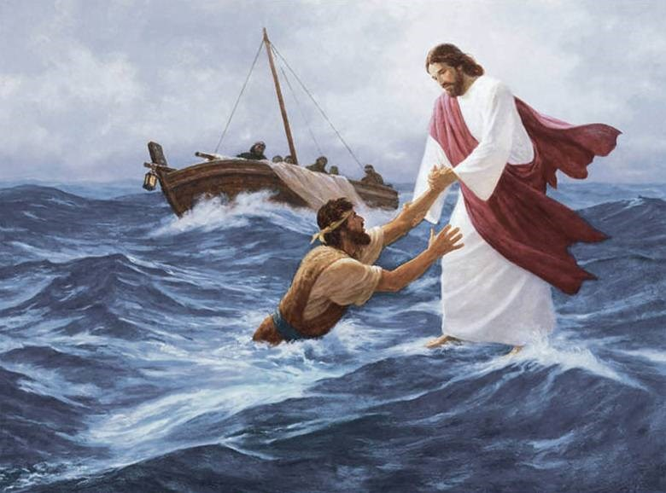
Christian Leadership
Christ-Like Leadership

Slide 2

Why is Christian Leadership Important?

